Slide 1
Unit 5 Series Circuits
Part A: Identify Series Circuits

Slide 2
What will you learn?
Identify a series connection.

Slide 3
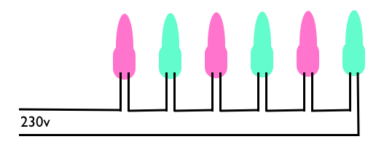

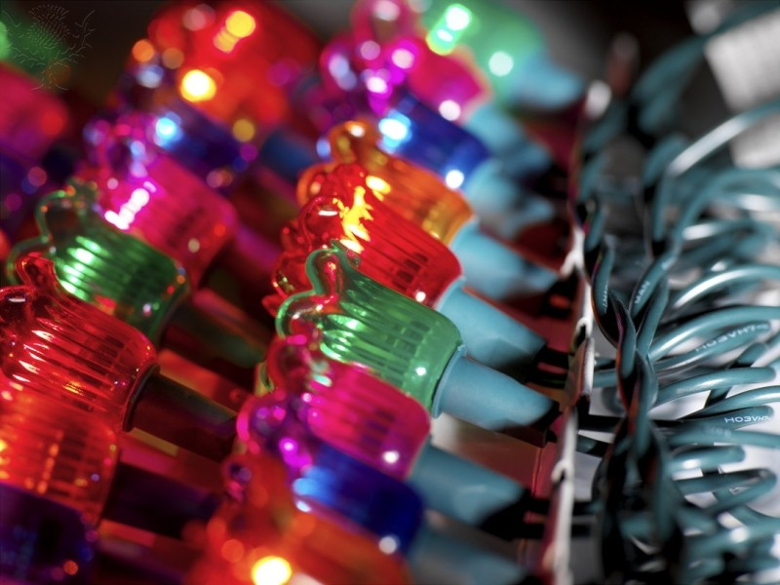
Identifying a series connection
You have seen a Christmas tree lighting.
When its power is turned on
all the lights glow at the same time.
If they twinkle, they twinkle together too.
Yes, they display a variety of colours.
The supply voltage can be about 100 V or 200 V (only a few volts across each bulb).
These light bulbs are wired in a string or “in series” to receive the power

Slide 4
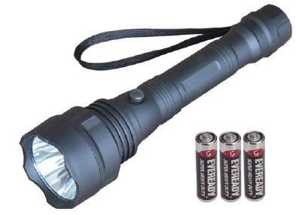
Identifying a series connection
You have used a torch light.
The light bulb receives its power from its battery pack.
The pack consists of a stack of three 1.5 V batteries connected in series providing the required 4.5 V EMF.

Slide 5
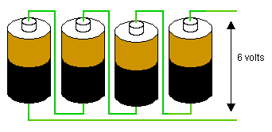
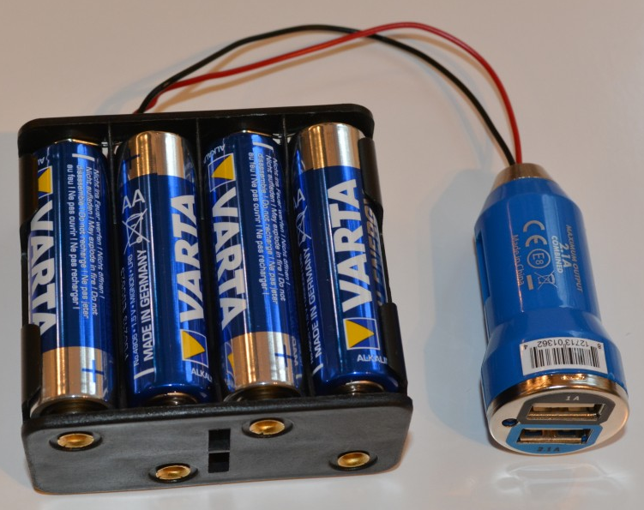
Identifying a series connection
In many applications, batteries (or dry cells) are commonly connected in series to provide a higher voltage or EMF.

Slide 6


Identifying a series connection
When you come to identifying a series connection of components in a schematic diagram, you look out for the following features:
Between two chosen points (A and B) in a given circuit
There are two or more components connected.
The same current flows through each component.
I
I

Slide 7
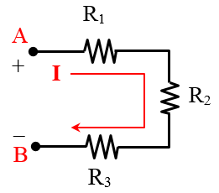
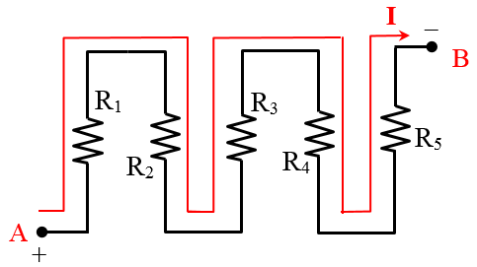
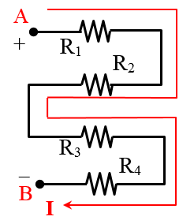
Identifying a series connection
Note:
Components need not be in a straight line.
The same current flows through each component.

Slide 8
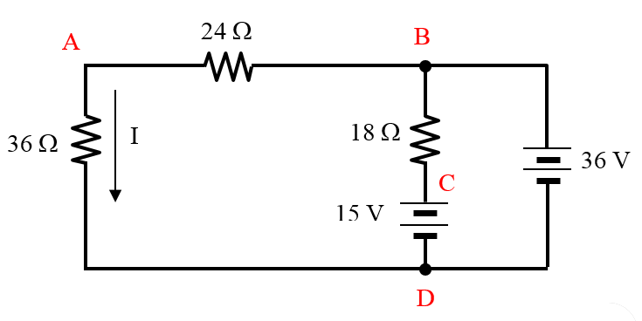

Example 1: Identify a series connection in the circuit.
Can you identify another series connection in the diagram?
There are two resistances (24 Ω and 36 Ω) having the same current flowing along the path B-A-D
not in series
in series
in series

Slide 9
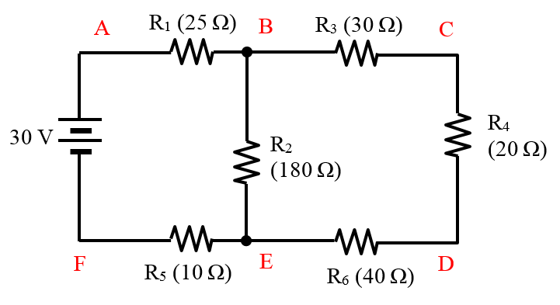

Example 2: Identify the series connection in the schematic diagram.
There is one path along B-C-D-E that resistances R₃, R₄ and R₆ are receiving the same current.
I
So resistances R₃, R₄ and R₆ are connected in series across B and E.

Slide 10


Identifying a series connection
The same concept also applies to connection of cells.
The effective voltage and polarities at A and B depend on the connection of the cells

Slide 11
You have learned that
a series connection consists of two or more components, and
the same current flows through each component.

Slide 12
Coming Up Next
Laws and Rules Governing Series Circuits

